Slide 1
Fitness Guru
By: Jared, Ely, Cynth, Joe, Coraline and Christian

Slide 2



Project Overview and our Goals
Fitness Guru is a comprehensive web platform designed to help users achieve their health and fitness goals by providing personalized workout plans, nutrition tracking, and wellness insights. The product is designed for individuals across all fitness levels, offering customized guidance and tracking with integrated AI-powered suggestions and real-time progress monitoring.

Slide 3


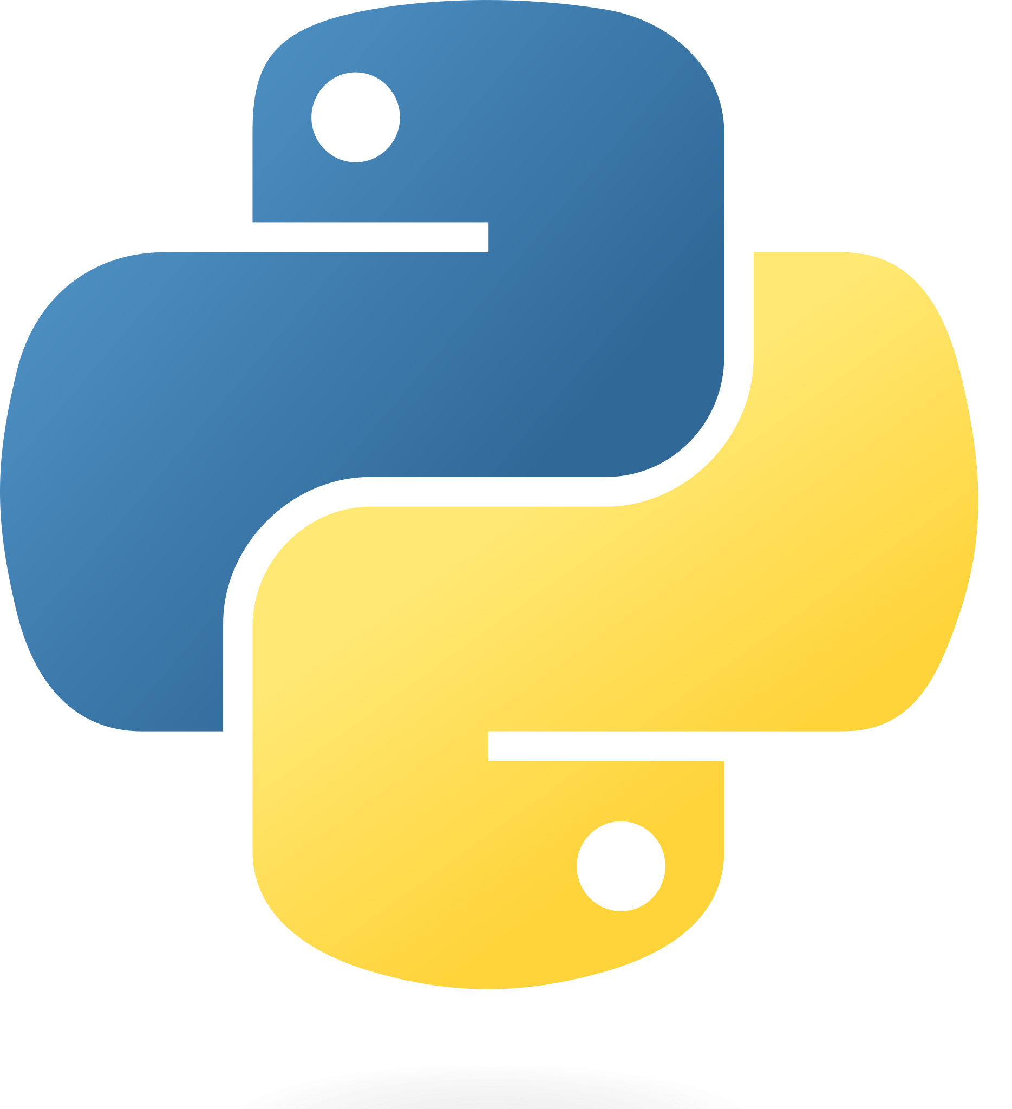

Technology Stack
Docker, Python, HTML/CSS, JavaScript, ChatGPT, Flask, PostgreSQL, Github, and Discord

Slide 4

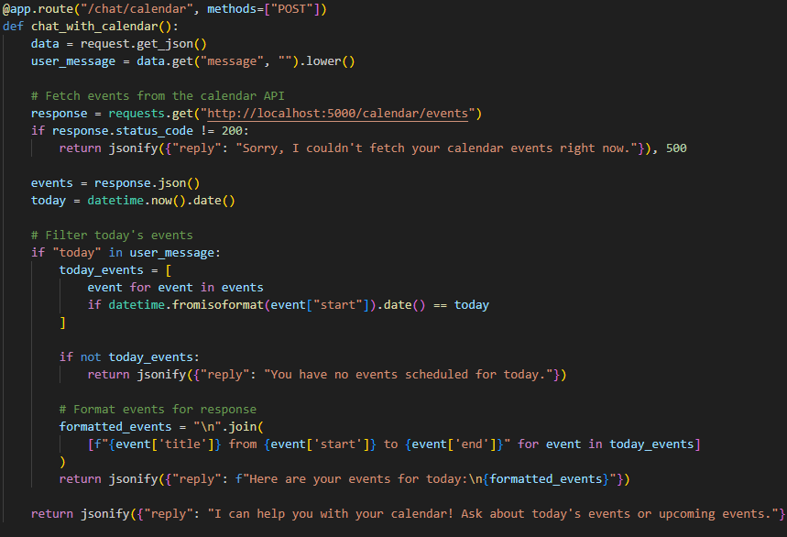
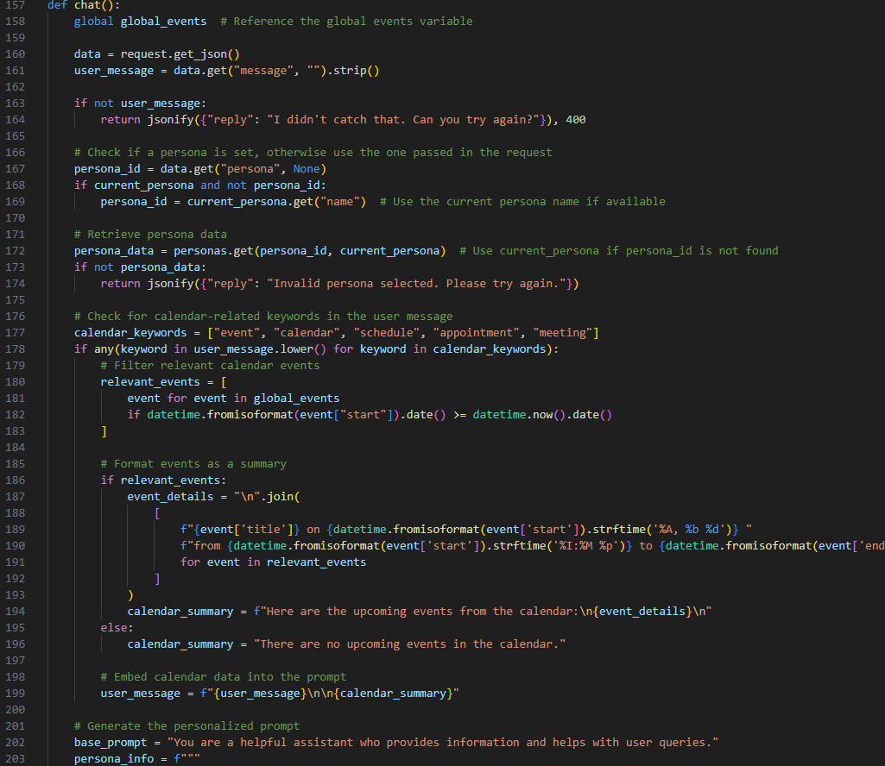
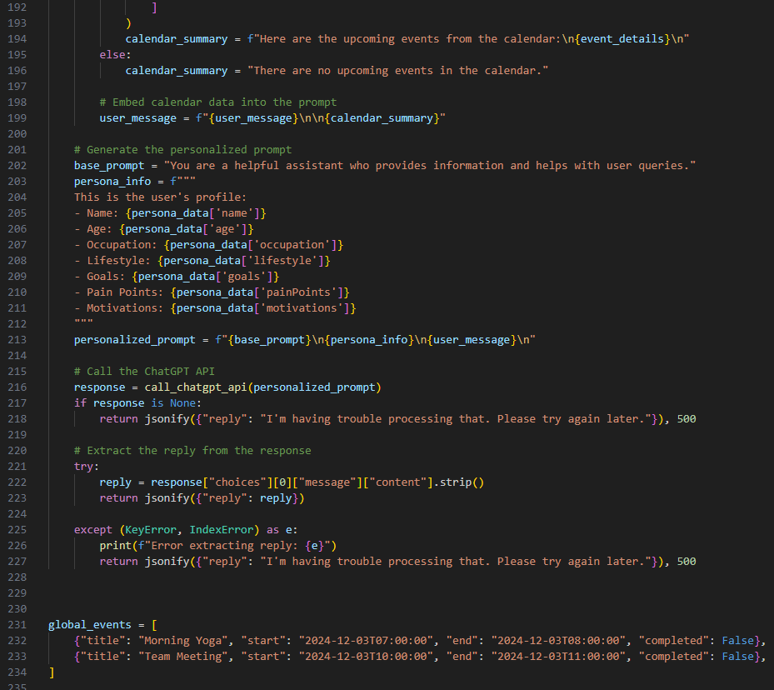
System Architecture: Chatbot

Slide 5
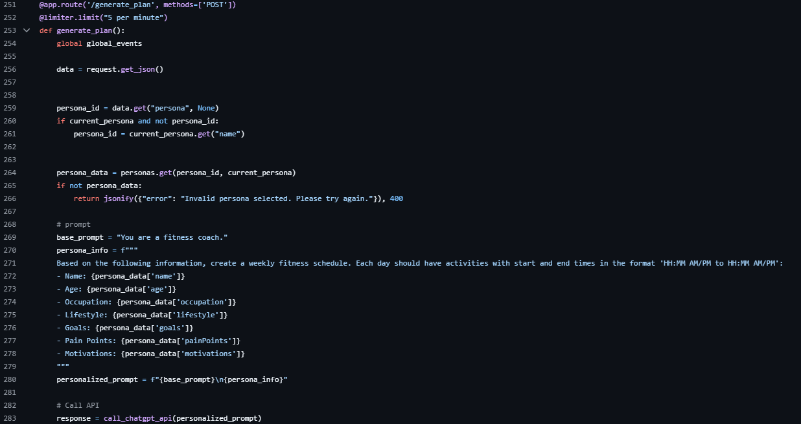
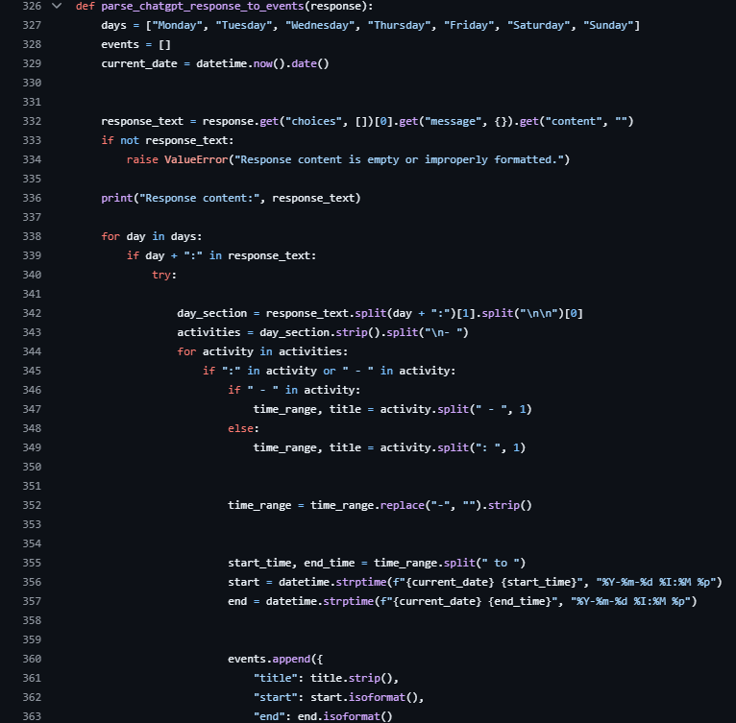

System Architecture: Calendar
After the persona is selected, it is sent to ChatGPT with a prompt that includes the format needed for the response
The response is parsed and put into the correct json format for the calendar

Slide 6

Roles and Responsibilities
Project Manager (Shared): Ensures milestones are met, facilitates communication, and resolve issues.
Front-end (Jared, Ely): Designs and develops the user interface, focusing on usability and aesthetics.
Back-end (Cynth, Joe): Develops the server-side logic, database management, program main features and functions.
Tester (Coraline): Conducts testing, identifies bugs, and ensures quality assurance through integration and unit tests
DevOps (Cristian): Sets up and manages deployment pipelines, Docker configurations and flask server.

Slide 7
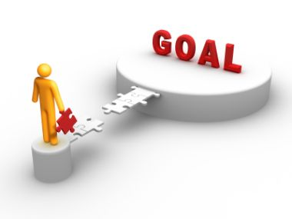
Sprint Goals
Sprint 1: Personas, Plan features, User info form,
UI landing page, Docker Container,
Flask server Setup
Sprint 2: Front End communication with JSON server, connection to chatgbt, integrate Calendar, communication with chatbot and calendar
Sprint 3: Finish connections and display outputs, AI Chatbot, Finish up UI, Testing,
Workflow, and polishing/fine-tuning
Notes:
Sprint 1: Foundation Setup
User Info Form: Designed and implemented a form to collect user data.
UI Landing Page: Created the initial landing page for the user interface.
Docker Container: Configured a Docker container for streamlined development and deployment.
Flask Server Setup: Set up and tested the Flask server, ensuring it serves basic endpoints.
Sprint 2: Core Functionality Integration
Frontend Communication with JSON Server: Connected the frontend with a JSON-based backend to enable seamless data exchange.
Integration with ChatGPT: Established a connection to the ChatGPT API for chatbot functionality.
Calendar Integration: Implemented calendar features for scheduling and reminders, ensuring proper synchronization.
Sprint 3: Final Touches and Testing
Finalize Connections: Ensured all systems (frontend, backend, AI, and calendar) are fully integrated and communicating correctly.
AI Chatbox: Completed development and refinement of the AI-powered chat interface.
UI Enhancements: Polished the user interface for a professional and user-friendly experience.
Testing: Conducted rigorous testing to ensure functionality, performance, and user satisfaction.

Slide 8
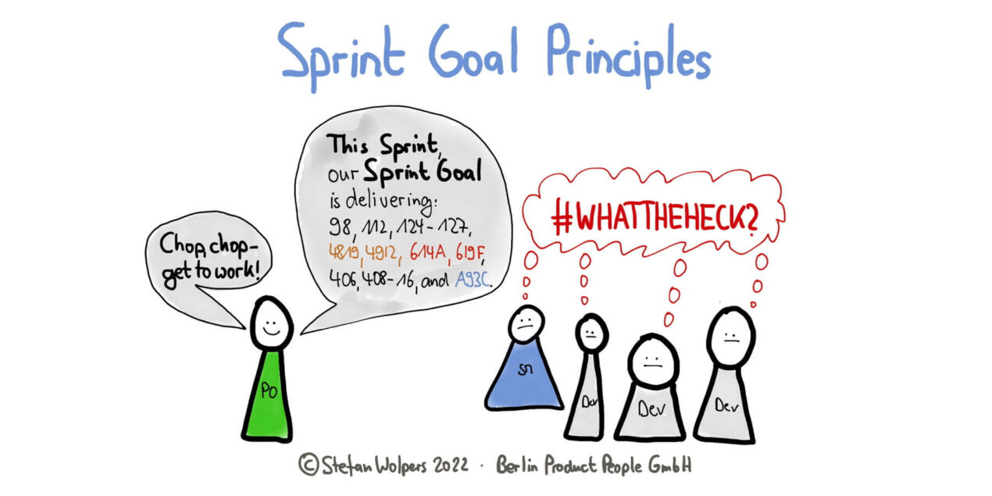

Sprint Retrospective
-Trouble sticking to plans
-Not much communication outside of class
-Didn’t keep up with Jira or github issues
-Issues tying features together (Calendar with persona/goal selection and chatbot)
-Could have potentially fixed these issues if they were identified earlier
-Dropped features due to time constraints
Notes:
Sprint 1: Foundation Setup
User Info Form: Designed and implemented a form to collect user data.
UI Landing Page: Created the initial landing page for the user interface.
Docker Container: Configured a Docker container for streamlined development and deployment.
Flask Server Setup: Set up and tested the Flask server, ensuring it serves basic endpoints.
Sprint 2: Core Functionality Integration
Frontend Communication with JSON Server: Connected the frontend with a JSON-based backend to enable seamless data exchange.
Integration with ChatGPT: Established a connection to the ChatGPT API for chatbot functionality.
Calendar Integration: Implemented calendar features for scheduling and reminders, ensuring proper synchronization.
Sprint 3: Final Touches and Testing
Finalize Connections: Ensured all systems (frontend, backend, AI, and calendar) are fully integrated and communicating correctly.
AI Chatbox: Completed development and refinement of the AI-powered chat interface.
UI Enhancements: Polished the user interface for a professional and user-friendly experience.
Testing: Conducted rigorous testing to ensure functionality, performance, and user satisfaction.

Slide 9


Tech Issues
-Could not edit calendar from chatbot
-Custom goal selection unable to be used in chat
-Setting up tests for each part of the program and having them all pass at once
-Passing live updating calendar data
-Chatbot not having memory of previous chats
-Chatbot response rigidity
Notes:
Sprint 1: Foundation Setup
User Info Form: Designed and implemented a form to collect user data.
UI Landing Page: Created the initial landing page for the user interface.
Docker Container: Configured a Docker container for streamlined development and deployment.
Flask Server Setup: Set up and tested the Flask server, ensuring it serves basic endpoints.
Sprint 2: Core Functionality Integration
Frontend Communication with JSON Server: Connected the frontend with a JSON-based backend to enable seamless data exchange.
Integration with ChatGPT: Established a connection to the ChatGPT API for chatbot functionality.
Calendar Integration: Implemented calendar features for scheduling and reminders, ensuring proper synchronization.
Sprint 3: Final Touches and Testing
Finalize Connections: Ensured all systems (frontend, backend, AI, and calendar) are fully integrated and communicating correctly.
AI Chatbox: Completed development and refinement of the AI-powered chat interface.
UI Enhancements: Polished the user interface for a professional and user-friendly experience.
Testing: Conducted rigorous testing to ensure functionality, performance, and user satisfaction.

Slide 10

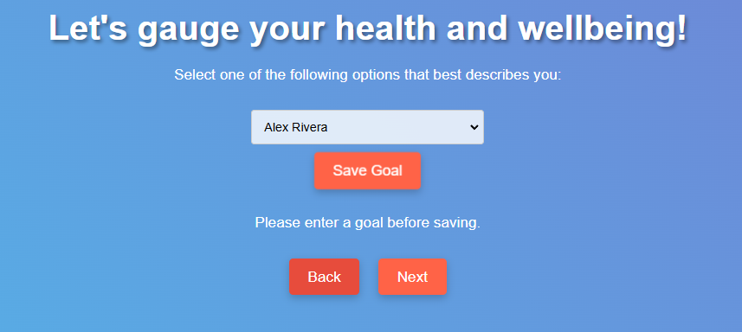
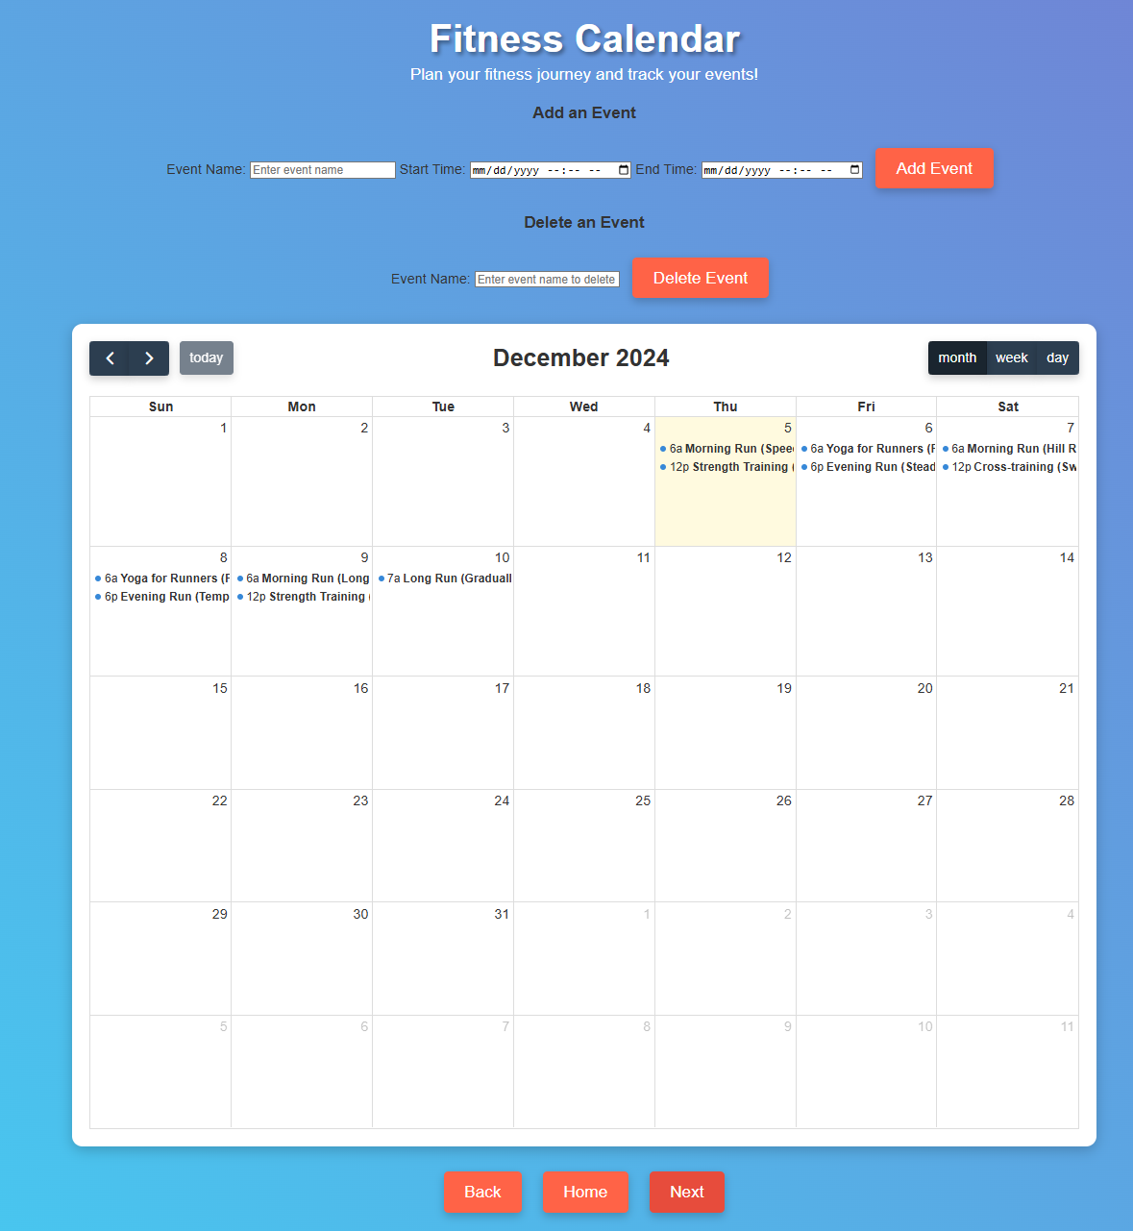
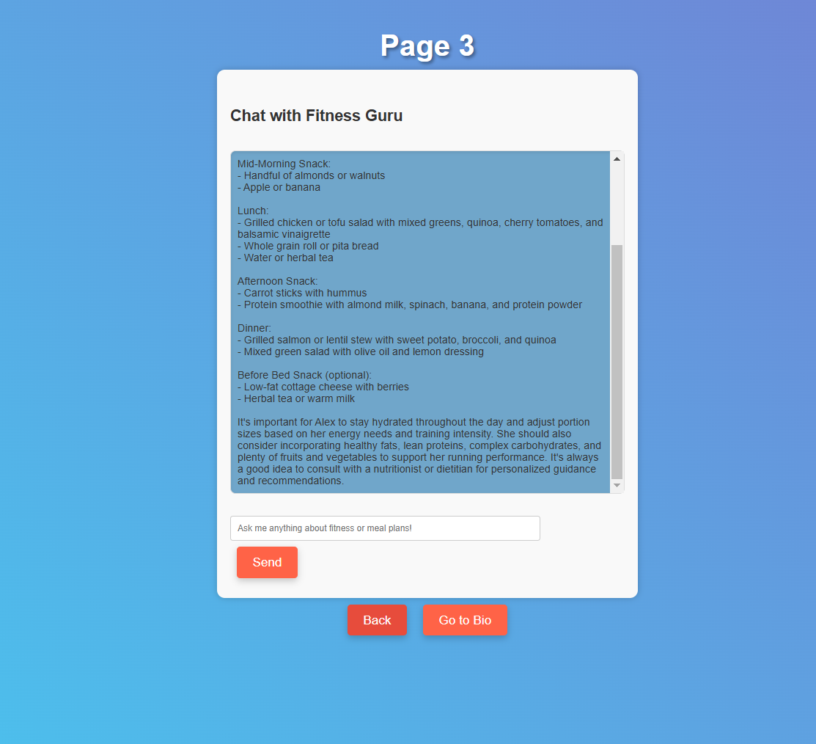
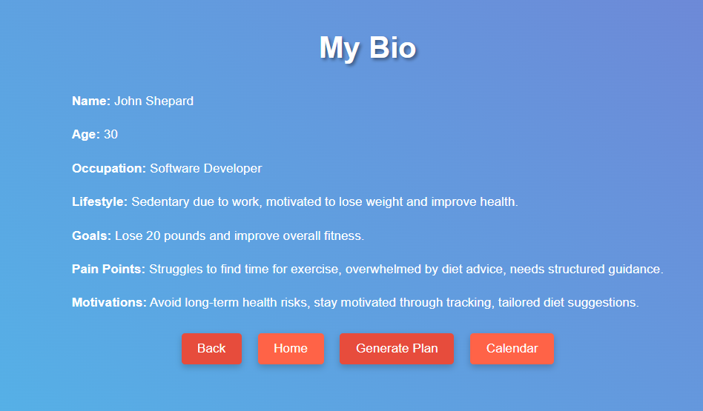
Live Demo

Slide 11
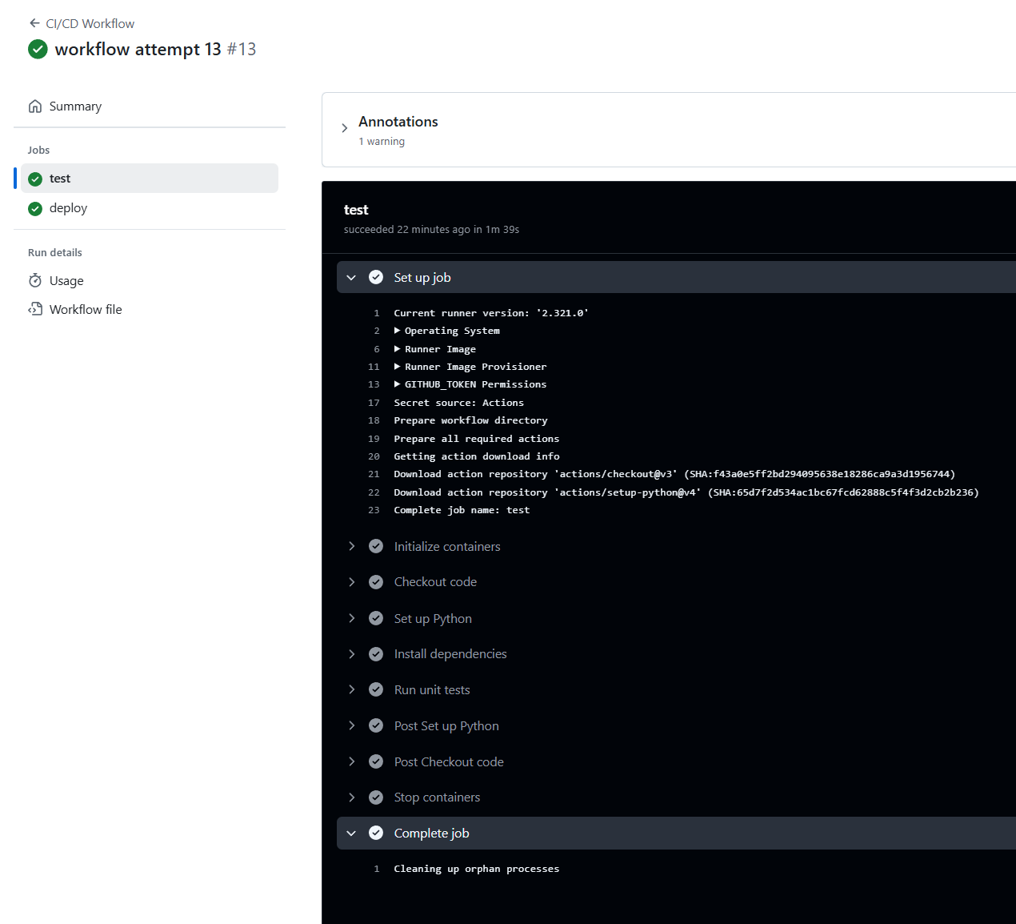
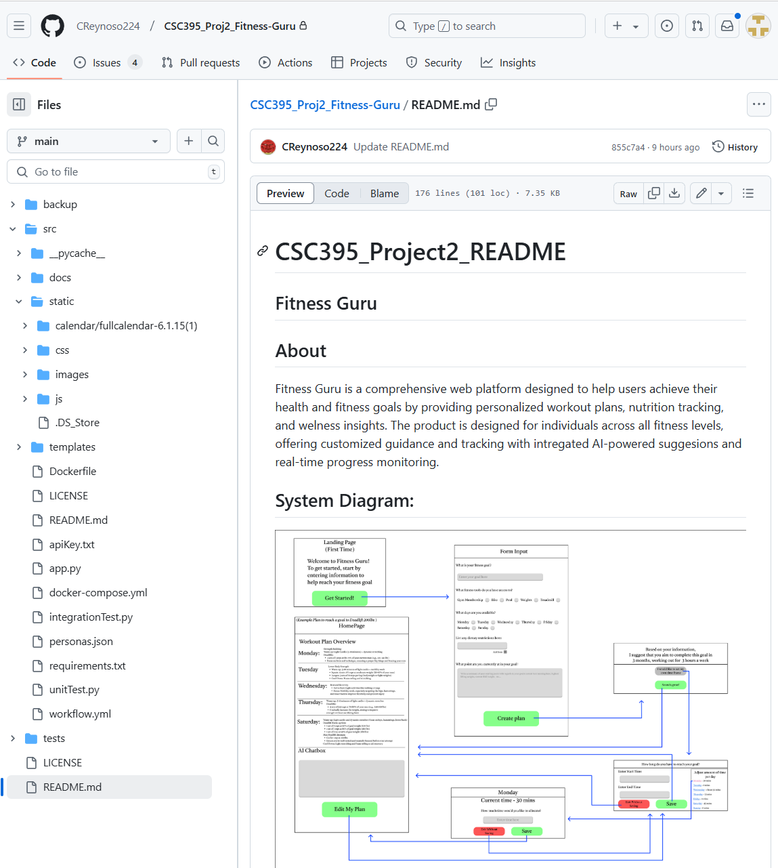
GitHub Repository / Workflow

Slide 12

The End

